Slide 1
Process of National Consolidation and Integration of Indian States
The situations held dangerous potentialities and that if we did not handle it promptly and effectively, our hard- earned freedom might disappear through the states’ door.
- Sardar Vallabhai patel

Slide 2
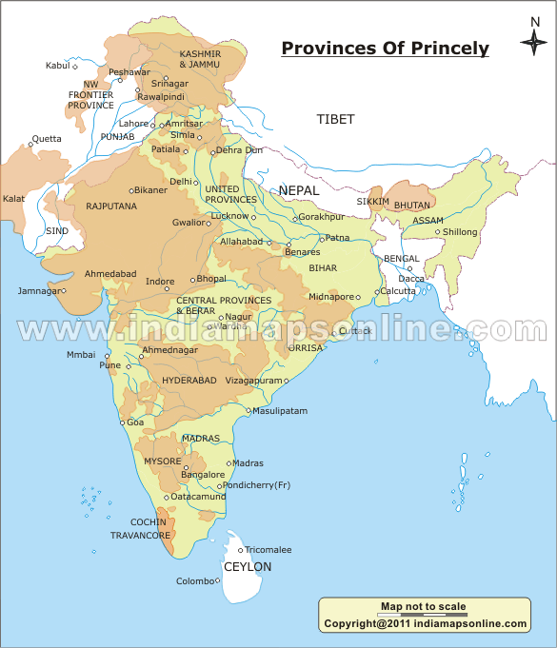

Slide 3
Introduction:
Integration of Princely States into Indian territory just started after India attained independence.
Uniting its people together with vast diversity in cultures, customs, languages etc,-Biggest Challenge.
Most arduous and difficult task for the Indian leadership in the post- Independence era was the Unification of India under one administration.
Integration of Indian States
Prior to Independence, there were 565 princely states in India
Over 400 Princely states were smaller than Twenty square miles.

Slide 4
Some of the States were large like
Hyderabad (Hindu majority/ Ruled by Muslim Nizam)
Mysore
Travancore
Patiala
Jaipur
Jodhpur
Bikaner
Kashmir ( Muslim majority/ Ruled by Hindu Maharaja)
Population of the Princely states formed 26% of the total population covering 46% of the total area of the British India.
1947 future of these states once the British left became a matter of concern.

Slide 5
Many larger princes began to dream of Independence and wanted to achieve it.
Their ambition were fuelled by BPM Clement Atlee announcement 20th Feb 1947 ‘ His majesty’s Government does not intend to hand over their powers to any government of British India’.
As a result rulers of several states claimed that they would become independent from 15th August 1947.
Operation Princes
Lord Mountbatten launched Operation Princes on 25 July 1947 at a meeting of the Chamber of Princes with 2 ponts.
Princes would be offered an Instrument of Accession, conceding rights on foreign affairs, defense and communication which they had never enjoyed before.
They had to decide whether to accede or to remain independent well before 15 August 1947.

Slide 6
An overwhelming number of princely states except Travancore, Kashmir, Junagath and Hyderabad acceded to India.
Integration of Princely States
27th June 1947, a separate States’ Department created under Patel with V.P. Menon as his secretary.
To get the consent of the Princes to the Act of Accession. Using both persuasion and pressure , Patel succeeded in integrating the hundreds of princely states with Indian Union.
Scared of the rising tide of the peoples’ movement in their states, Patel's reputation for determinism and even ruthlessness, majority of the princes responded positively.

Slide 7
Accession of Travancore
Far advanced state
Sir.C.P. Ramaswamy Iyer, all power Diwan of the princely state.
Feb 1946 itself made clear when the British left Travancore would become a ‘ perfectly Independent Unit’
He contacted British Company, American Consul at Madras to seek U.S recognition for the state independence.
Travancore bid for Independence was welcomed by Mohammed Ali Jinnah.
People of princely state rose in revolt against Diwan rule- led by Communist backed by Congress
On 30th July 19467the Maharaja wired the viceroy of his decision to accede to the Indian Union.

Slide 8
Accession of Junagath
Tiny princely state in Kathiwar peninsula on the coast of Sourashtra near Bombay.
Hindu majority state rued by Muslim Nawab.
This state shared common border with Pakistan.
Nawab declared the accession of his state to Pakistan.
Government pointed out that the state was 80% Hindu, and called for plebiscite to decide the question of accession.
People opposed rose in rebellion, Nawab fled to Pakistan
To control Law and Order Indian armed force marched into the states
Plebiscite was conducted in Feb 1948- went almost unanimously in favour of accession to India.

Slide 9
Accession of Kashmir
State of Kashmir had strategic importance on account of its international boundaries.
Less populated and economically unviable : 3/4th of its populations was muslim.
The State was strategically located at a vital cross road where India, Pakistan China was destined to meet.
Kashmir was ruled by Maharaja Hari Singh
Maharaja Hari Singh was toying with the idea of maintaining the Independence of Kashmir
He rejected the Instrument of Accession
Three days before partition the Maharaja propossed a Stand – Still agreement with India and Pakistan.
Popular Political parties took steps wanted to join with India.
Patel declared in August 1947 that Kashmir was free to join either India or Pakistan in accordance with the will of the people.

Slide 10
Attack from Tribals from Pakistan.
Since the Maharaja was reluctant to oblige Pakistan/ Pakistan engineered ‘ a tribal invasion’ of Kashmir, on 15th October 1947.
Tribal operation was carefully planned and executed.
Kashmir’s Accession
Maharaja appealed to India for military assistance.
Pointed out that under International law India could send its troops to Kashmir only after the state's formal accession to India.
On 26th October 1947 the Maharaja formally acceded Kashmir to India, and agreed to install Shiek Abdulla as head of the state.
In law, Jammu and Kashmir became an integral part of India.

Slide 11
Kashmir Issue and the UNO
In 1951 UN passed a resolution providing for referendum under UN supervision after Pakistan had withdrawn its troops from the part of Kashmir under its control.
Pakistan has refused to withdraw its forces from what is known as Azad Kashmir.
Northern and Western portions of Kashmir came under Pakistan’s came to be called as POK Pakistan occupied Kashmir.
On 1 January 1948, Nehru made a specific reference to UN Security council.
In August 1948, the U.N Commission for India and Pakistan (UNCIP) proposed the withdrawal of troops .
In December 1948 India accepted ceasefire on UNCIP terms.

Slide 12
Pakistan had secured an arc of mountains round the Kashmir Valley and western end of the valley known as ‘Azad Kashmir or Pakistan Occupied Kashmir (POK)
The Ceasefire Line remained the line at which firing was supposed to have stopped.
Security Council appointed a 5 member to suggest acceptable solutions.
Solutions (three) proposed were rejected either by India and Pakistan
Kashmir problem became one of the monumental proofs to the partial attitude and failure of the UNO.
Two wars 1965 and 1971.
Kashmir crisis might have been solved by the impartial stand of UNO…but?
The Kashmir issue since then remains “ like a fuse box”

Slide 13
Accession of Hyderabad
It was a landlocked state in southeastern India.
Majority people were Hindu, its ruler Nizam Osman Ali Khan was a Muslim.
Nizam indulged in intrigues and manoeuvres to keep Hyderabad state outside India as a “ Third Domonion”.
But a vast majority of his subjects wanted the state to accede to India.
Hyderabad State Congress launched the Join India Movement in May 1947
Congress party observed Join India Day on 7th August 1947
Nizam responded by unleashing force on the people.
Operation Polo in the 17th September 1948 moved in to control the Nizam’s forces.
This led to Hyderabad’s accession to India

Slide 14
Merger of Pondicherry (1956)
Agreement was signed on 28th May 1956 between India and France.
Parliamentary government was introduced in the territory.
In 1962 French settlements in India including Pondicherry, Karaikal and Mahi joined with Indian Union.
Annexation of Goa, 1961
Portuguese possession
Portuguese wanted to retain Goa/ Nehru tried his diplomatic method/ failed
In August 1955 tension mounted between two.
Govt of India was left with no alternative but to decide on police action.
In 1961 annexed with Indian Union.
Armed action was code named Operation Vijay.

